Slide 1

SECRET-SHARING SCHEMES
Authorship: Joel Aumedes and Marc Cervera

Slide 2
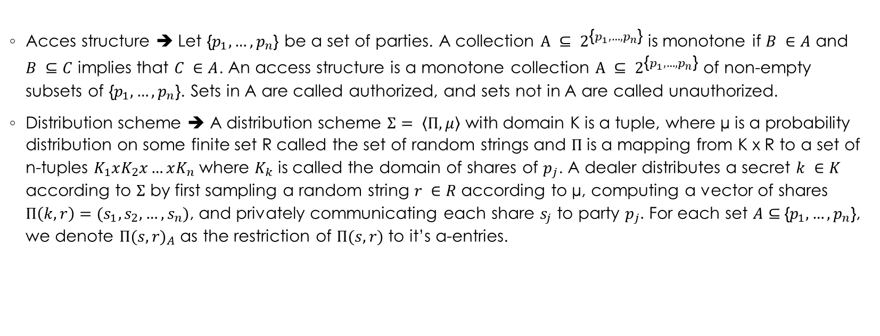
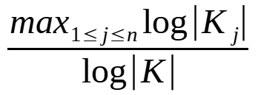
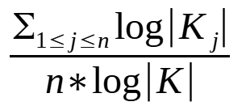
Definitions
Information ratio of a DS
Average information of a DS

Slide 3
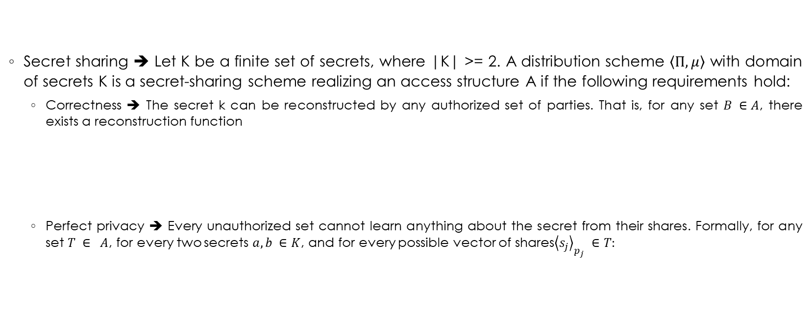

Definitions

Slide 4
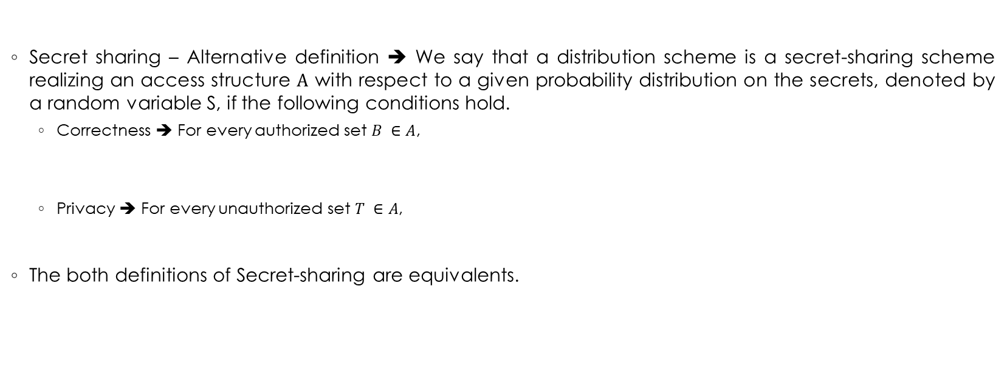


Definitions

Slide 5
Equivalent affirmations for a distribution scheme Σ
The scheme Σ is secure according to the first definition of Secret-sharing.
There is some distribution on the secrets with support K (that is, Pr[S = a] > 0 for every K) such that the scheme is secure according to the second definition of Secret-sharing with respect to this distribution.
For every distribution on the secrets whose support is contained in K, the scheme is secure according to the second definition of Secret-sharing with respect to the distribtution.

Slide 6
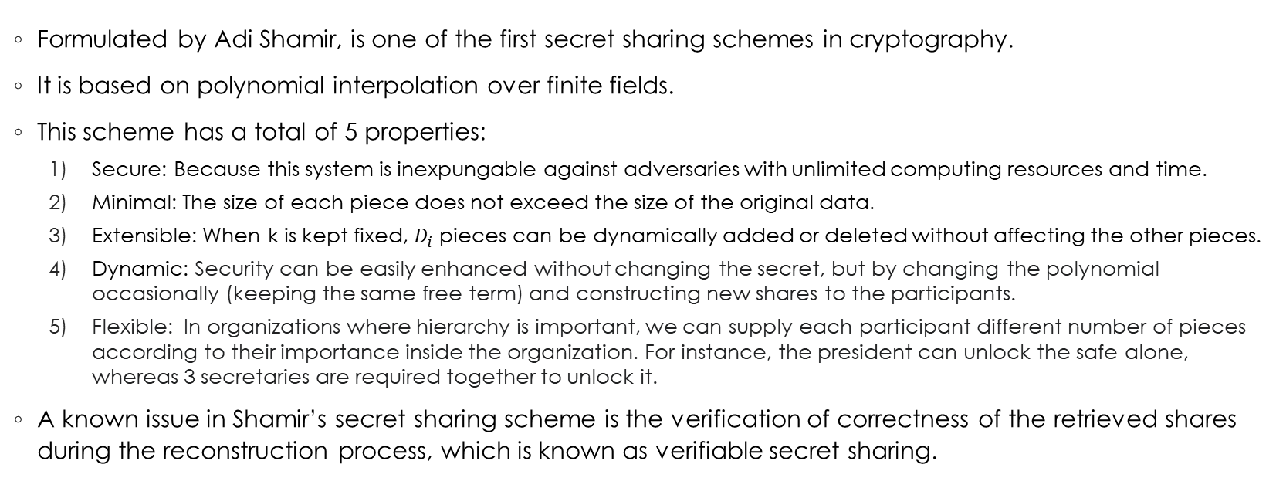
Shamir’s Secret-Sharing

Slide 7
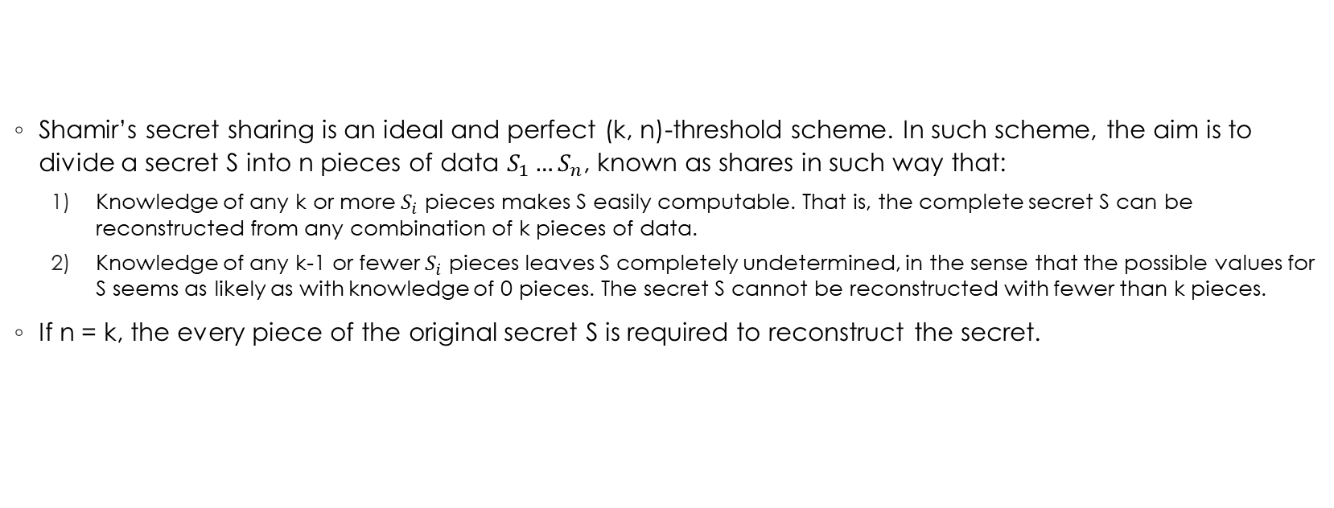
Mathematical formulation I

Slide 8
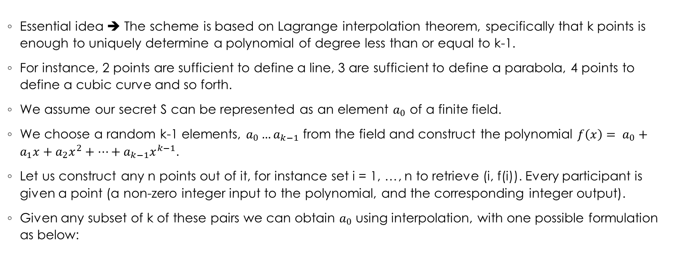

Mathematical formulation II

